Slide 1

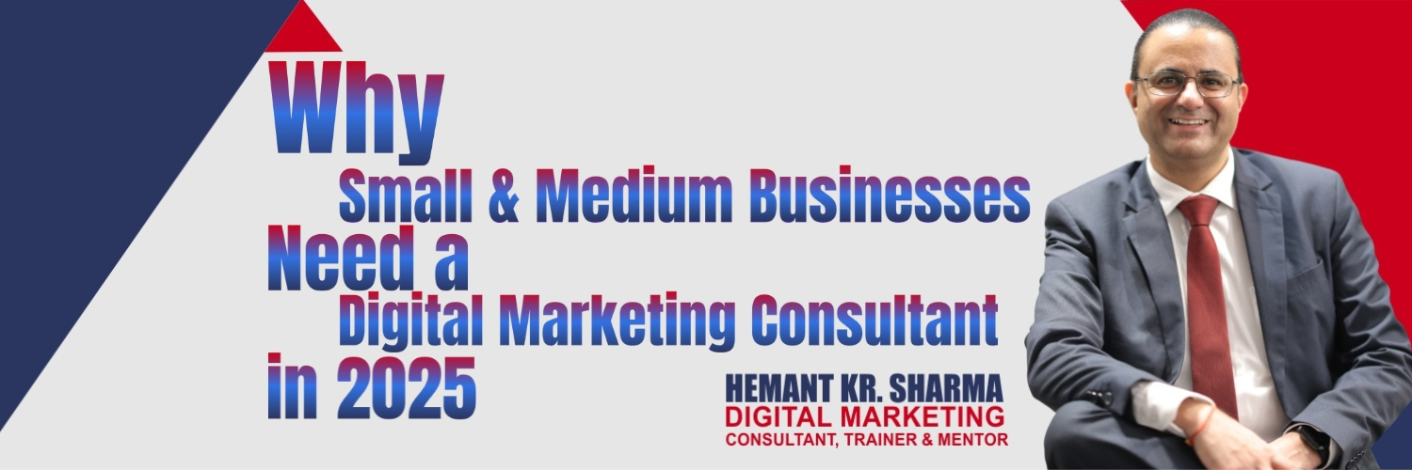

Why Small & Medium Businesses Need a
Digital Marketing Consultant
Hemant Kr. Sharma
TALK TO HEMANT
+91 9811681687 (Mobile & SMS)
+91 9999610527 (WhatsApp)
mail @ hemant . co . in
DIGITAL MARKETING CONSULTANT, TRAINER & MENTOR

Slide 2
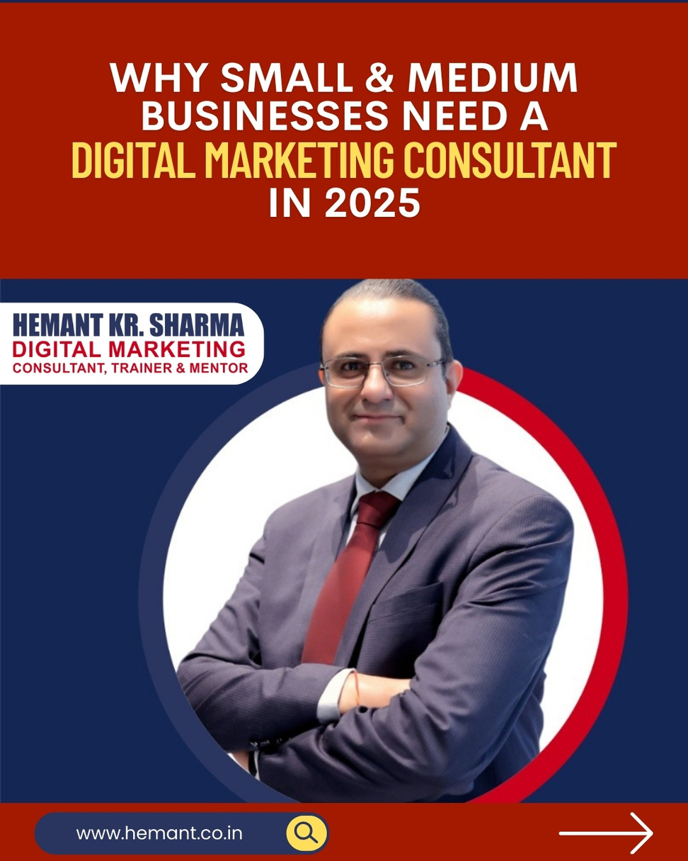
Why SMB Needs Consultant:
A consultant provides expert strategies, tailored solutions, and data-driven marketing to help businesses scale efficiently.

Slide 3
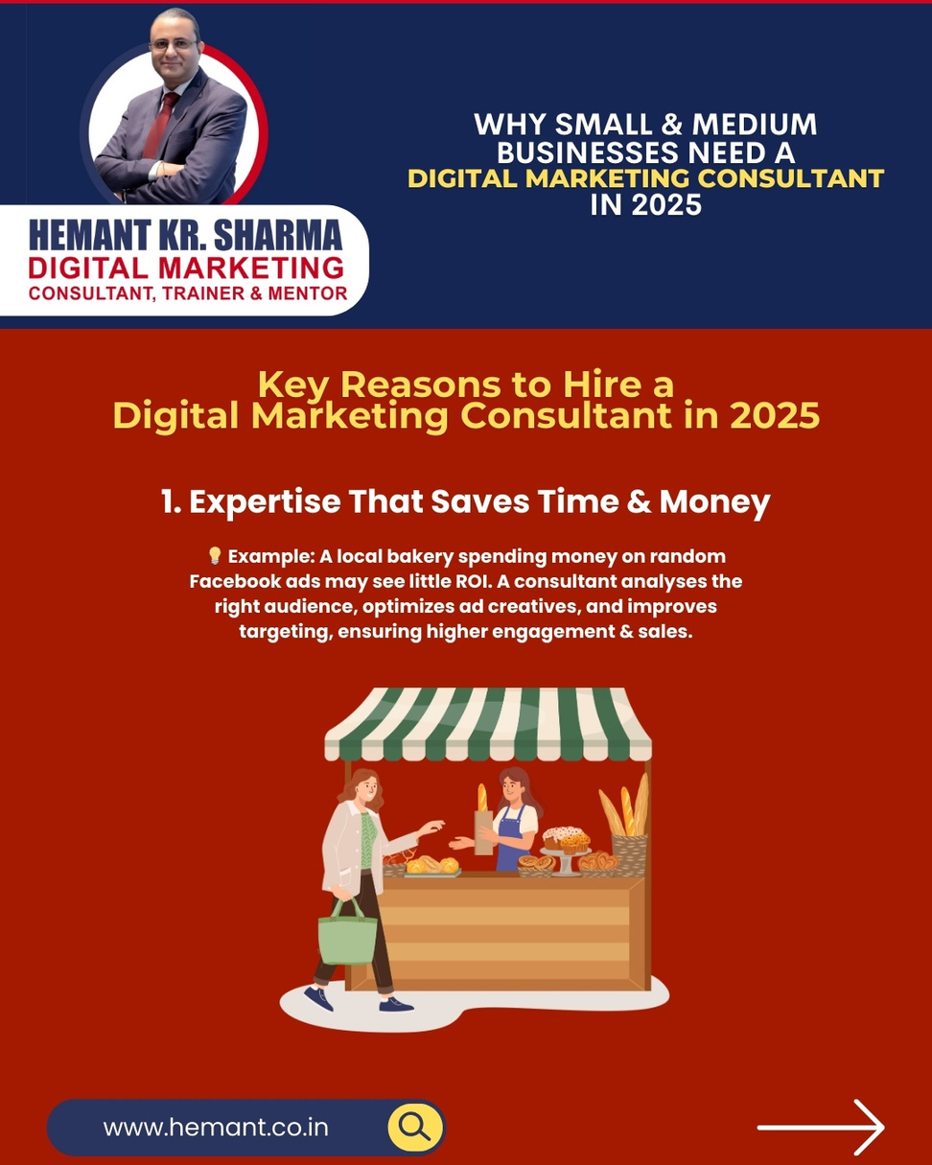
Expertise That Saves Time & Money:
💡 Example: A local bakery spending money on random Facebook ads may see little ROI. A consultant analyses the right audience, optimizes ad creatives, and improves targeting, ensuring higher engagement & sales.

Slide 4
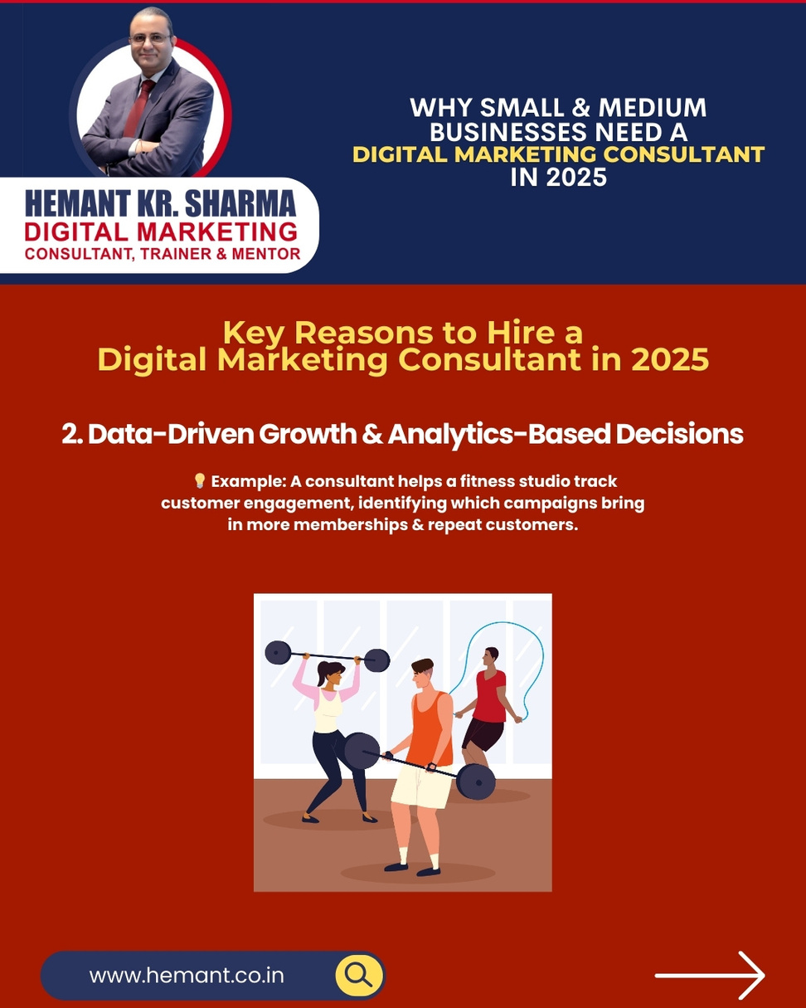
Data-Driven Growth:
💡 Example: A consultant helps a fitness studio track customer engagement, identifying which campaigns bring in more memberships & repeat customers.

Slide 5
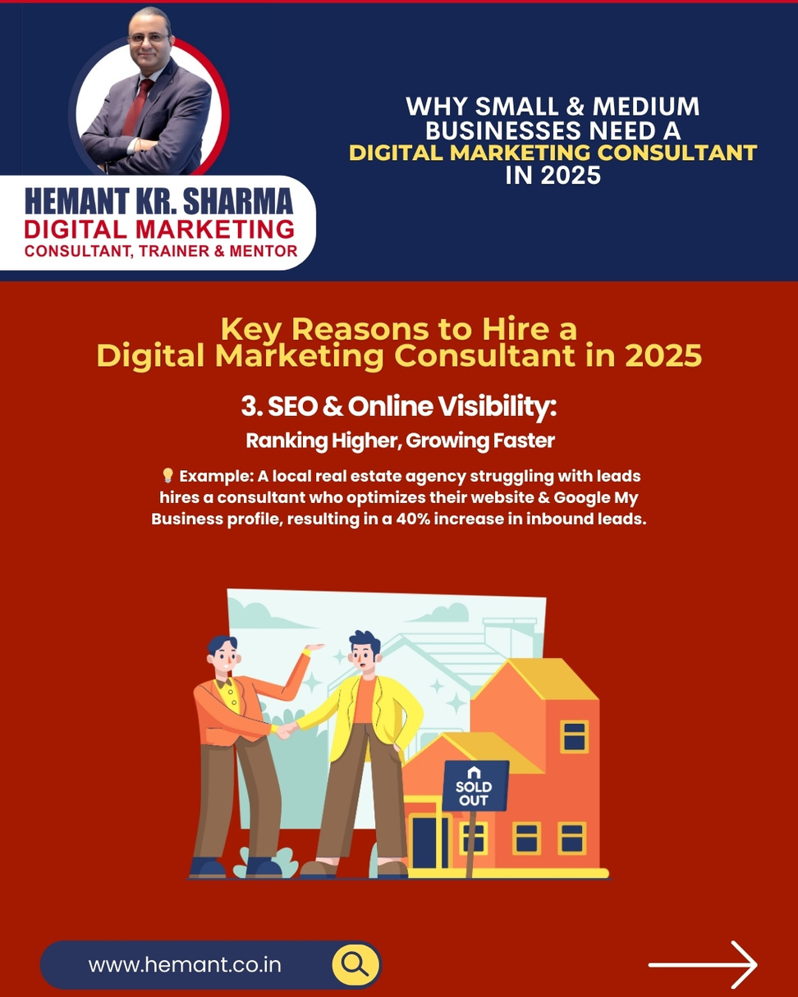
SEO & Online Visibility:
💡 Example: A local real estate agency struggling with leads hires a consultant who optimizes their website & Google My Business profile, resulting in a 40% increase in inbound leads.

Slide 6
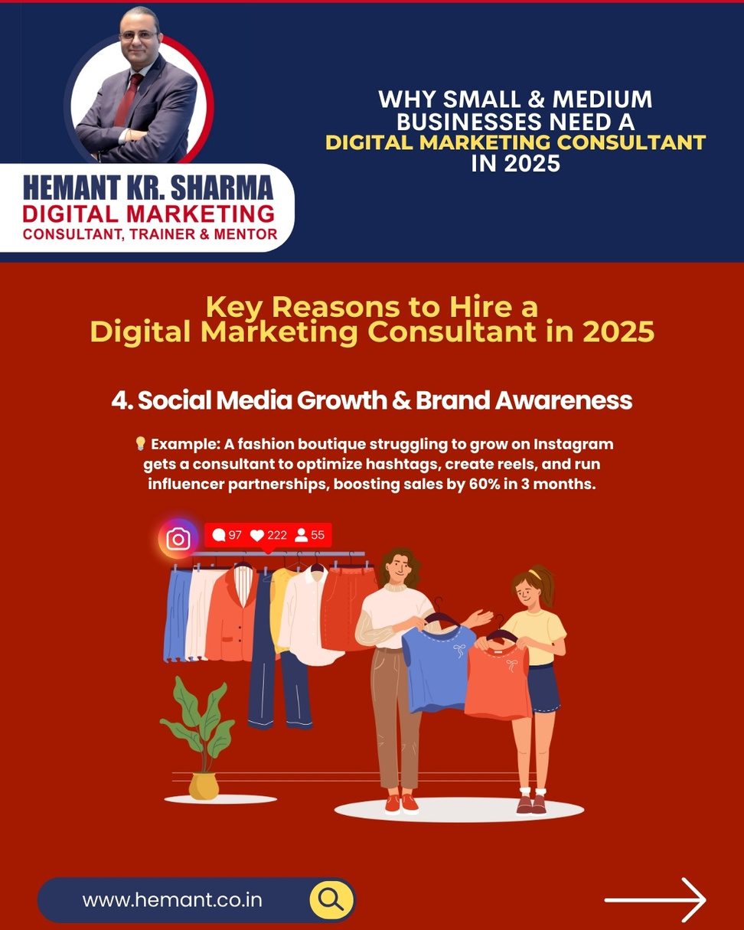
Social Media Growth:
💡 Example: A fashion boutique struggling to grow on Instagram gets a consultant to optimize hashtags, create reels, and run influencer partnerships, boosting sales by 60% in 3 months.

Slide 7
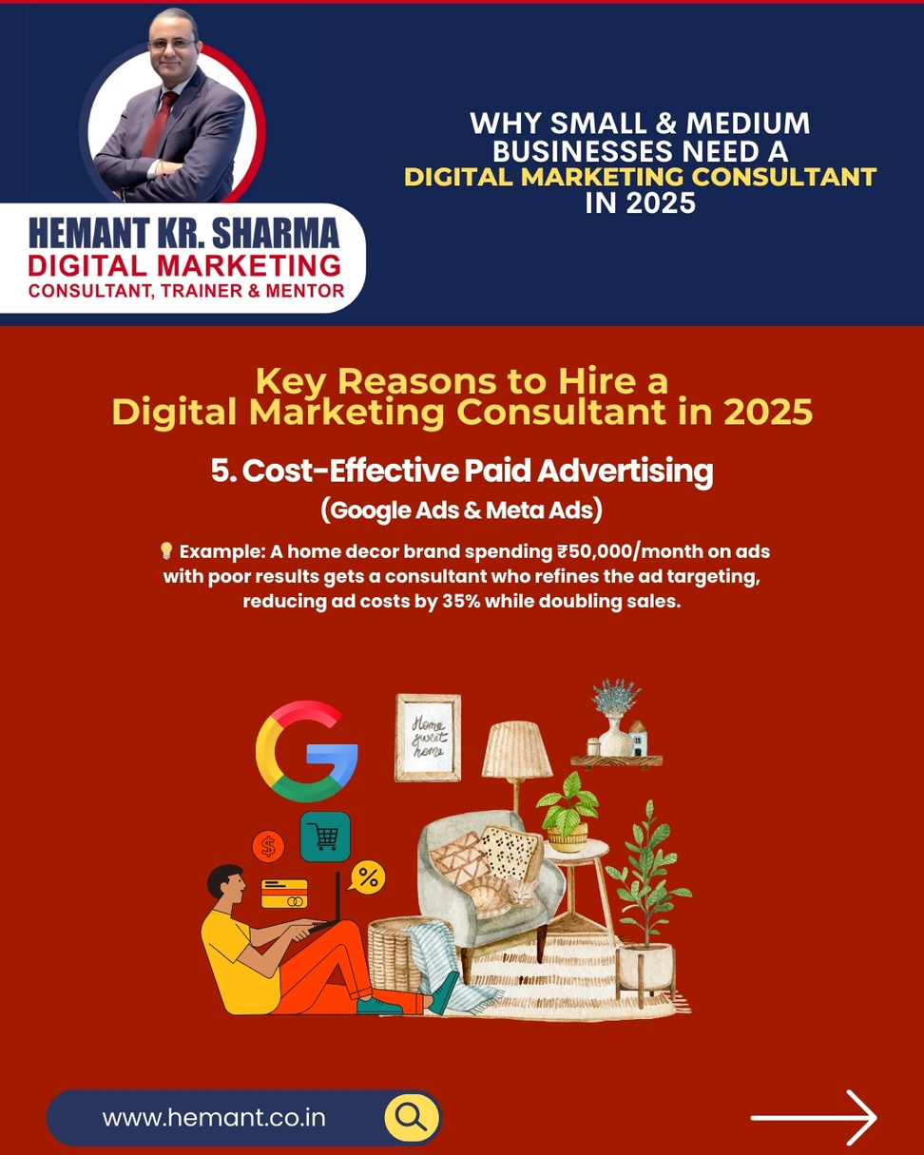
Cost-Effective Paid Advertising:
💡 Example: A home decor brand spending ₹50,000/month on ads with poor results gets a consultant who refines the ad targeting, reducing ad costs by 35% while doubling sales.

Slide 8
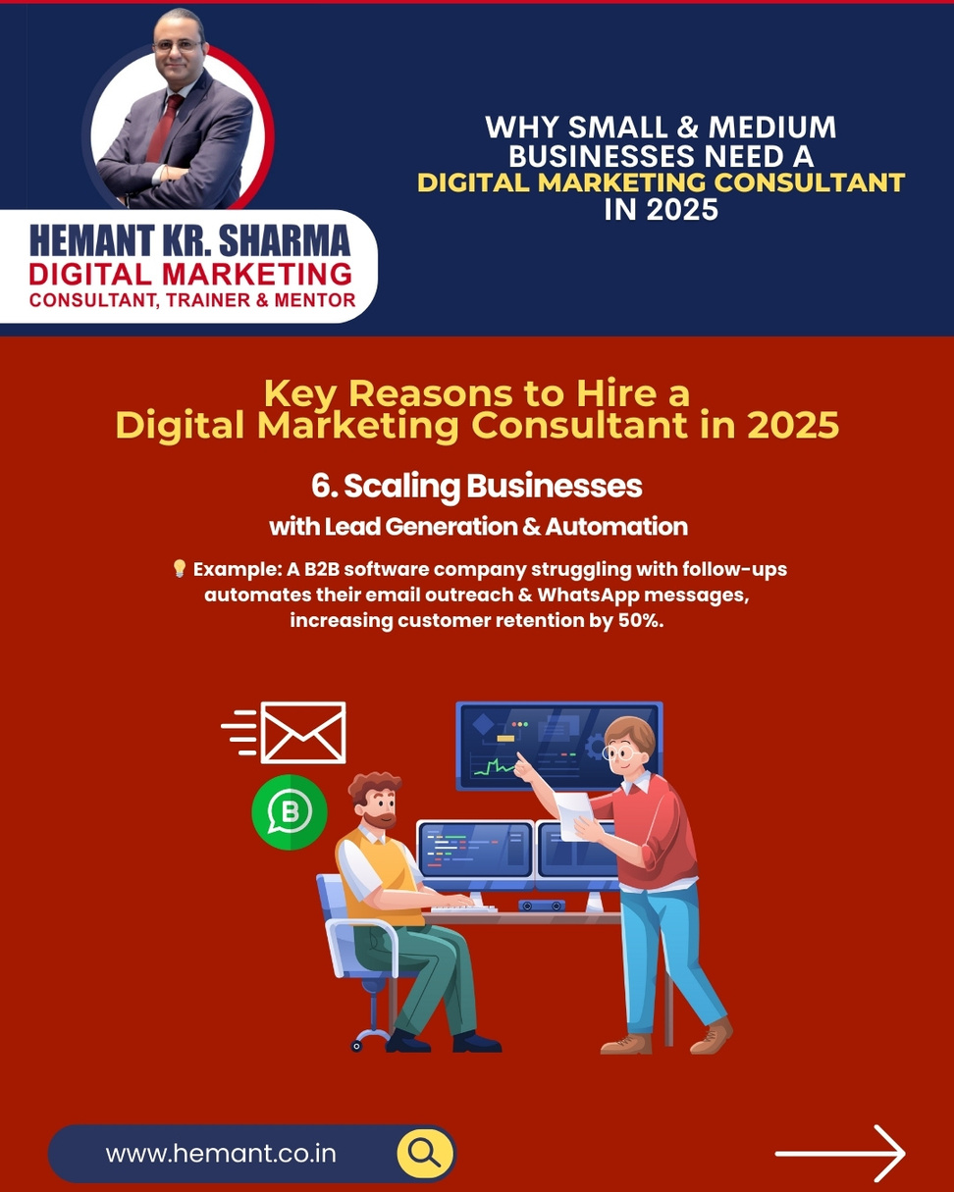
Scaling Businesses with Lead Generation:
💡 Example: A B2B software company struggling with follow-ups automates their email outreach & WhatsApp messages, increasing customer retention by 50%.

Slide 9
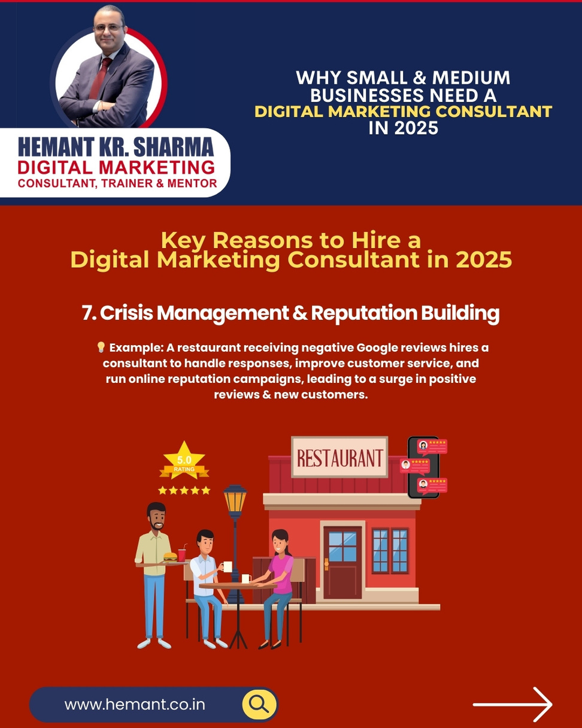
Crisis Management:
💡 Example: A restaurant receiving negative Google reviews hires a consultant to handle responses, improve customer service, and run online reputation campaigns, leading to a surge in positive reviews & new customers.

Slide 10
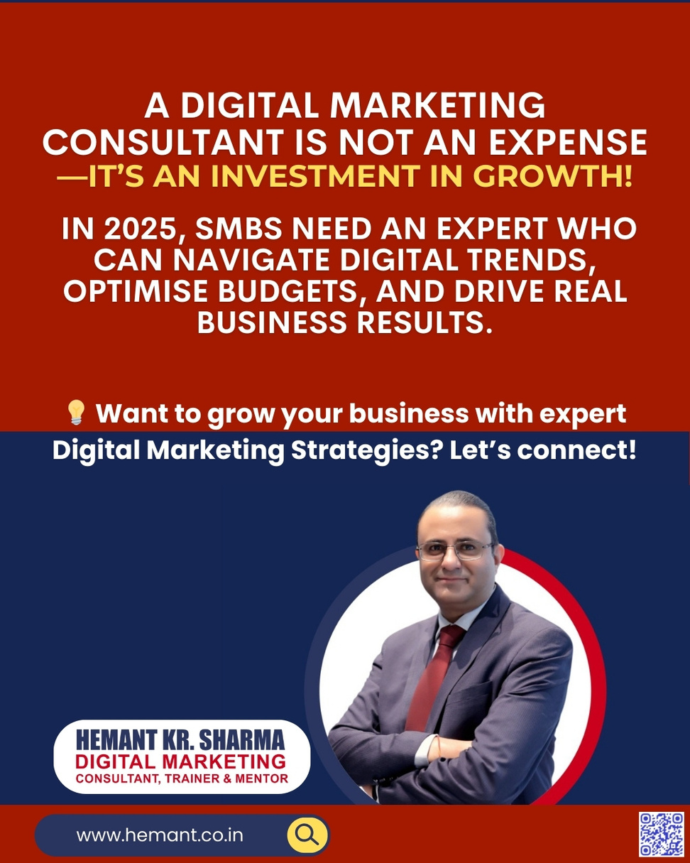
A Digital Marketing Consultant is not an expense—it’s an investment in growth!
💡 Want to grow your business with expert digital marketing strategies? Let’s connect!
📞 Call now: +91 98116 81687
💬 WhatsApp: Message us for a consultation!
#SocialMediaMarketing #SmallBusinessIndia #DigitalGrowth #InstagramMarketing #WhatsAppBusiness #MarketingTrends

