Slide 1
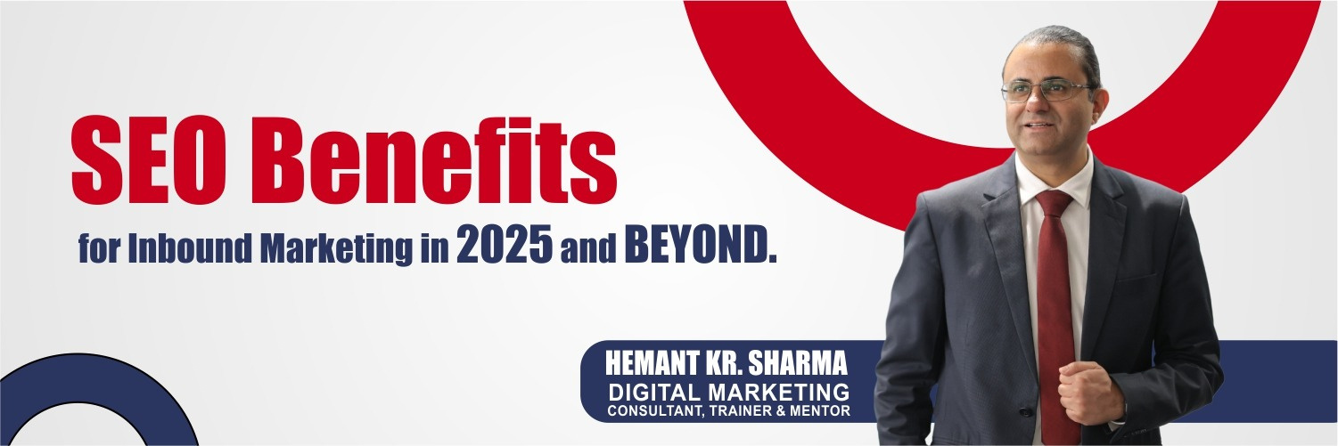

SEO Benefits for Inbound Marketing in 2025
Why SEO is More Relevant Than Ever in 2025
Hemant Kr. Sharma
TALK TO HEMANT
+91 9811681687 (Mobile & SMS)
+91 9999610527 (WhatsApp)
mail @ hemant . co . in
DIGITAL MARKETING CONSULTANT, TRAINER & MENTOR

Slide 2
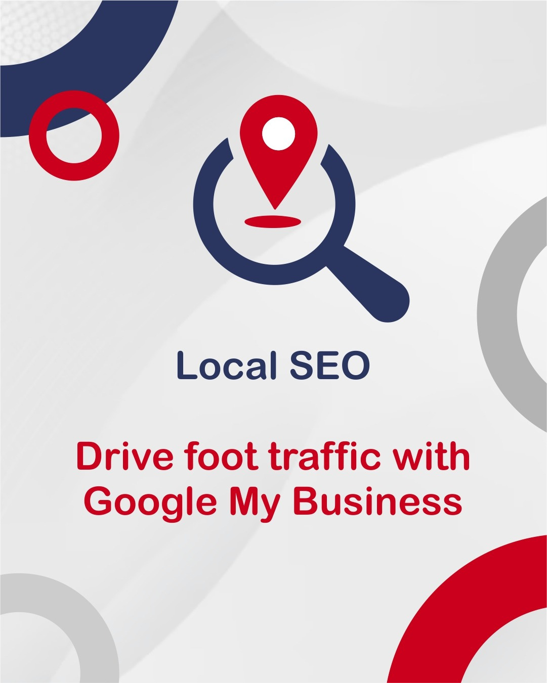
Organic Traffic is Still King:
Over 50% of all website traffic comes from organic search, proving that SEO remains the most powerful way to attract potential customers.

Slide 3
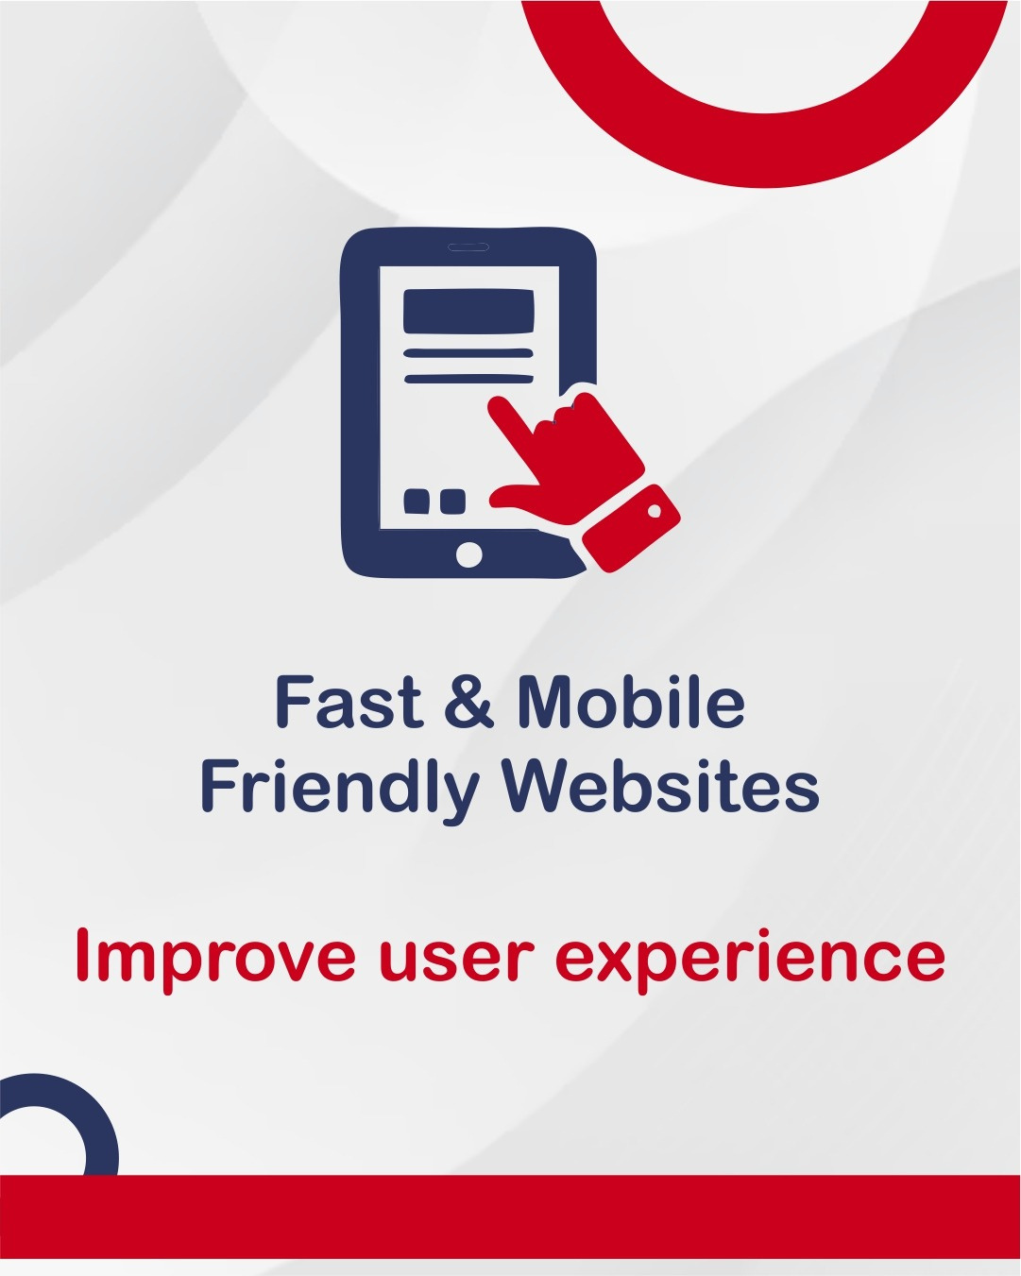
Users Trust Organic Results More:
Studies show that users are 8X more likely to click on an organic result than a paid ad, making SEO a critical part of brand trust-building.

Slide 4
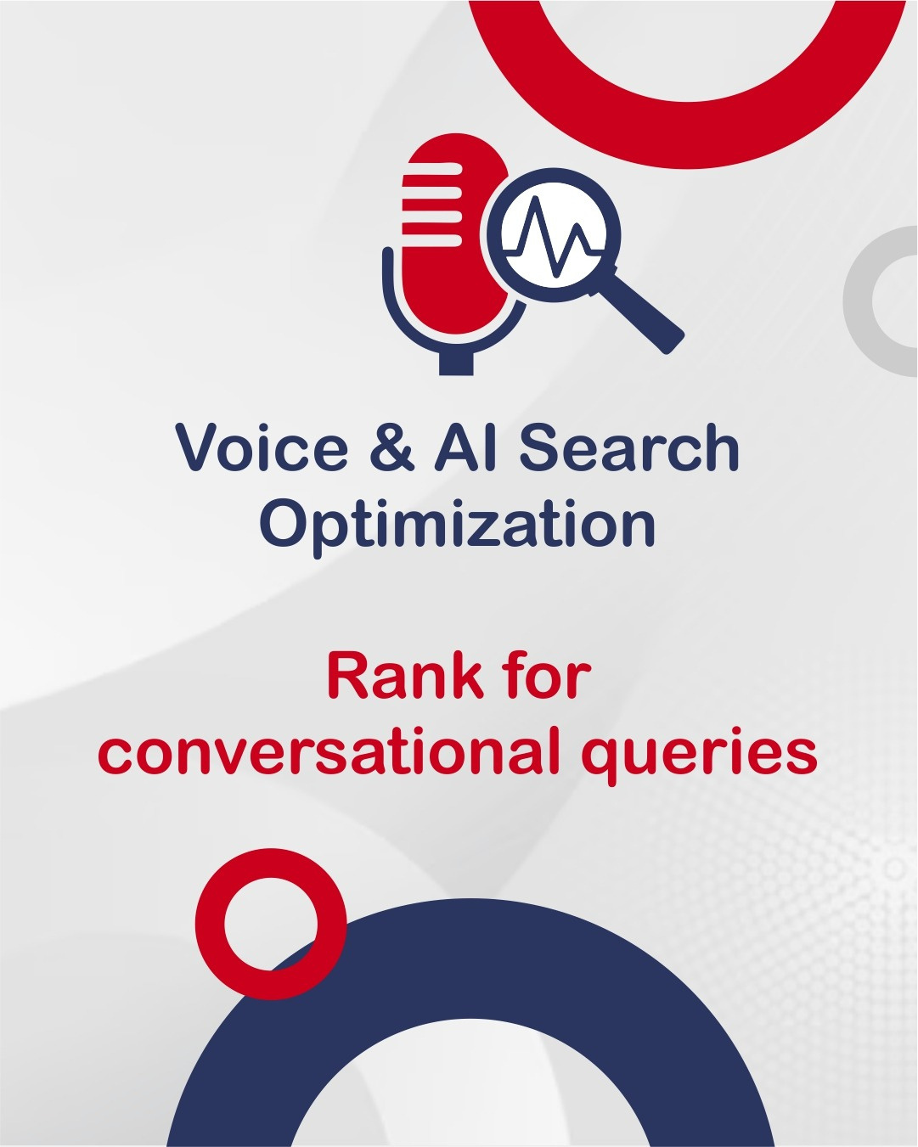
Voice & AI Search Are Growing:
With the rise of voice search, AI-powered assistants, and conversational AI like ChatGPT, optimizing for natural language queries is more important than ever.

Slide 5
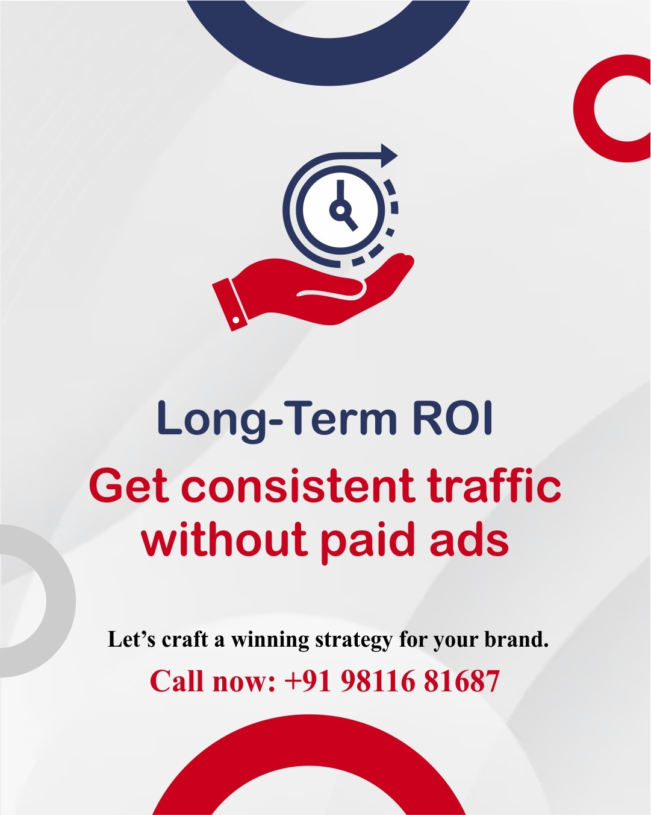
SEO Provides Higher ROI Than Paid Ads:
While Google Ads and paid campaigns offer immediate results, SEO delivers long-term traffic at zero ad spend, making it the most cost-effective marketing strategy.

Slide 6
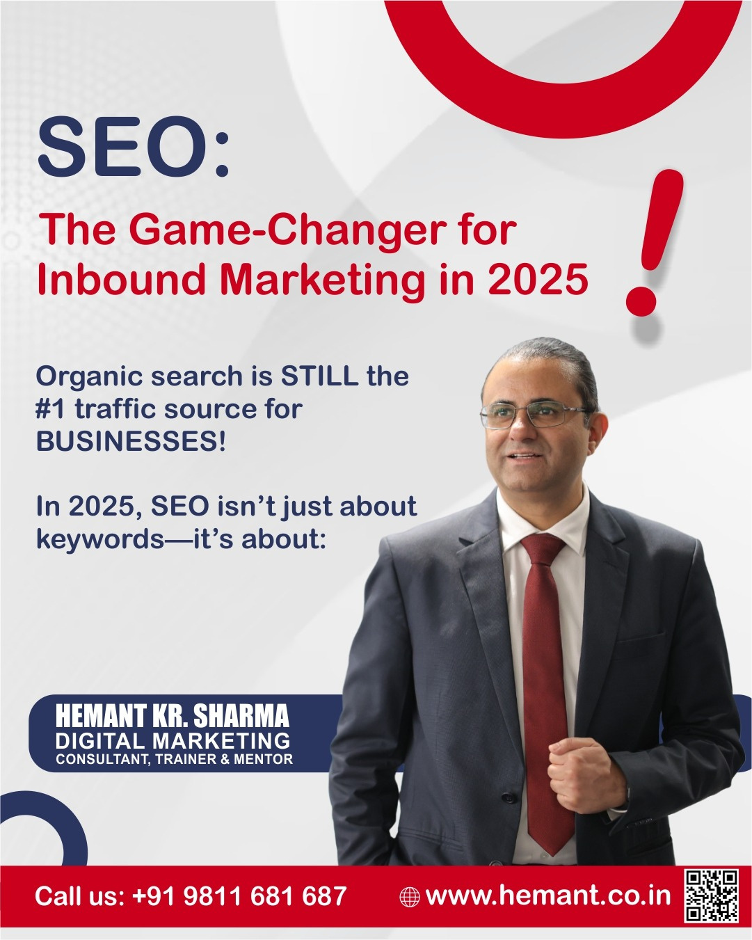
Businesses using search engine optimisation grows faster than those that don’t!
Are you using SEO to generate business leads? Drop a 🔥 in the comments if you're ready to scale your business online!
Get expert guidance on SEO, Social Media, Ads & More!
Let’s craft a winning strategy for your brand.
📞 Call now: +91 98116 81687
💬 WhatsApp: Message us for a FREE consultation!
#SocialMediaMarketing #SmallBusinessIndia #DigitalGrowth #InstagramMarketing #WhatsAppBusiness #MarketingTrends

