Slide 1
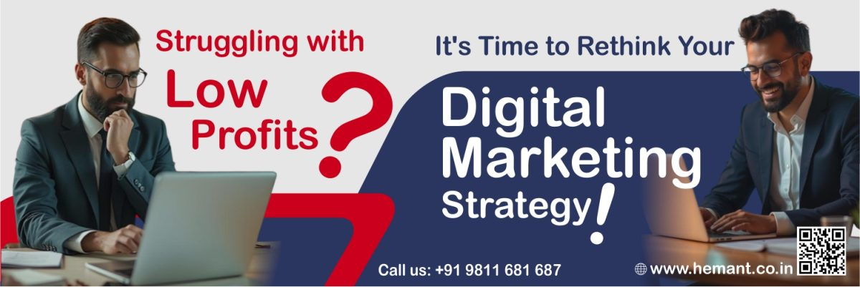
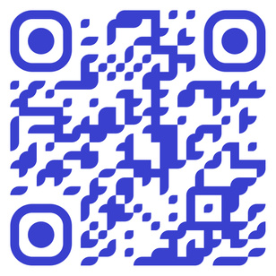
Digital Marketing Consultant Can Rescue a Business
how businesses experiencing low profits can be revived with the right digital marketing strategies.
Hemant Kr. Sharma
TALK TO HEMANT
+91 9811681687 (Mobile & SMS)
+91 9999610527 (WhatsApp)
mail @ hemant . co . in
DIGITAL MARKETING CONSULTANT, TRAINER & MENTOR

Slide 2

Identifying the Root Causes of Low Profit:
Before implementing solutions, a consultant first analyses the key reasons behind the financial struggle, which may includes:
  Lack of Online Visibility
  Weak Branding & Messaging
  Poor Marketing ROI
  and more...

Slide 3
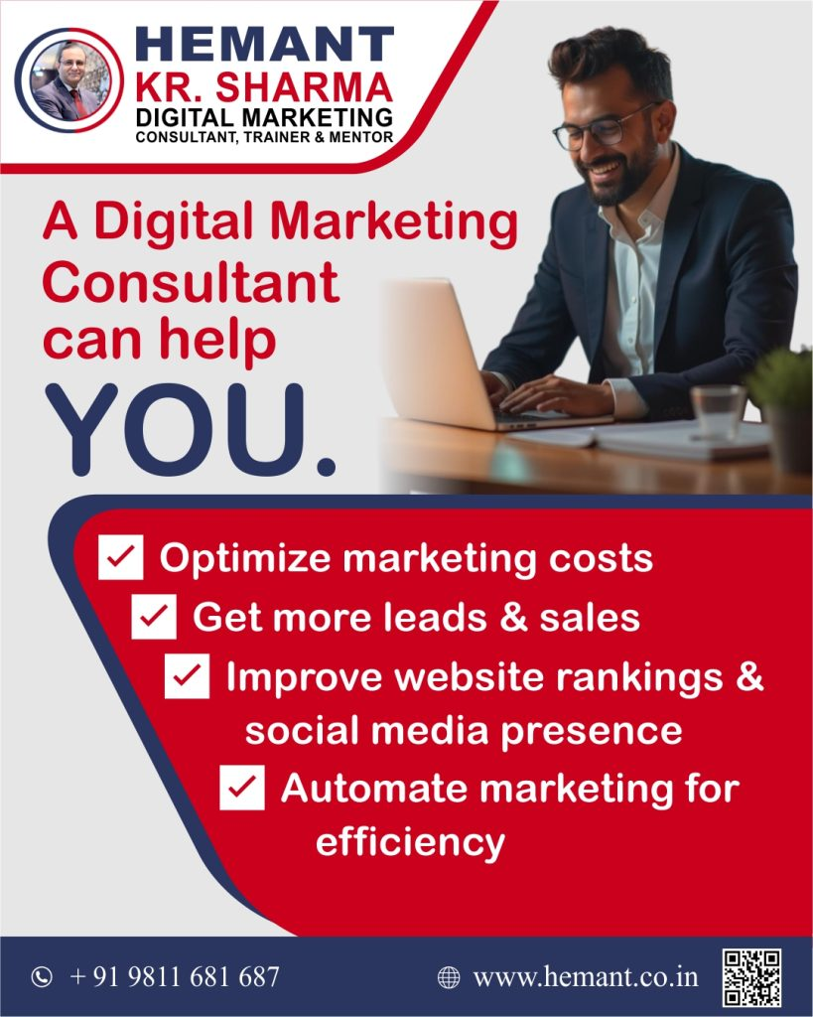
SEO and SMO Strategies Could Help:
Many businesses lose revenue simply because they don’t appear in search results when customers look for products or services. Low engagement on social media means missed opportunities for customer interaction and sales. A consultant ensures your business ranks higher on search engine and also bring you more visibility on social media

Slide 4




1
Paid Advertising
2
Lead Generation
Many businesses lose money due to inefficient ad campaigns on Google, Facebook, and Instagram. A consultant ensures ad budgets are utilised effectively by focusing on high-converting audiences.
A major reason for low profits is the lack of a proper lead nurturing system. A consultant helps create automated lead generation systems to convert inquiries into paying customers.
3
Customer Retention
4
Cost-Efficient Marketing
Businesses that focus only on acquiring new customers without retaining existing ones often suffer from low profit margins. A consultant helps improve customer retention strategies to increase lifetime customer value.
Digital marketing consultants integrate AI tools to optimize ad targeting, automate customer communication, and analyze business trends.

Slide 5
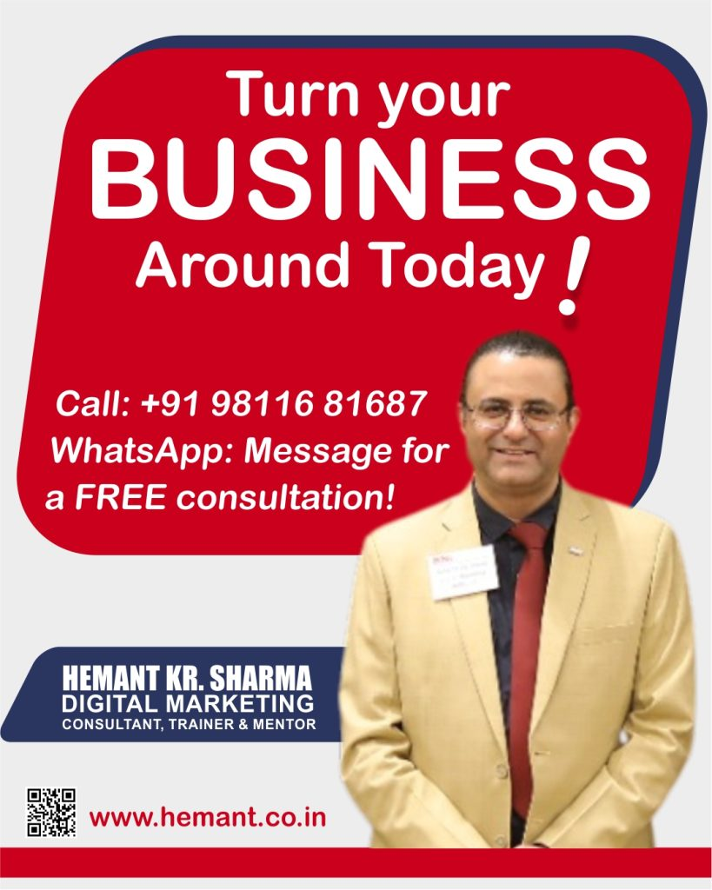
If your business is facing low profits, weak online presence, or inefficient marketing efforts, a Digital Marketing Consultant can help you cut costs, increase sales, and drive long-term growth.
Get expert guidance on SEO, Social Media, Ads & More!
Let’s craft a winning strategy for your brand.
📞 Call now: +91 98116 81687
💬 WhatsApp: Message us for a FREE consultation!
#SocialMediaMarketing #SmallBusinessIndia #DigitalGrowth #InstagramMarketing #WhatsAppBusiness #MarketingTrends

