Slide 1
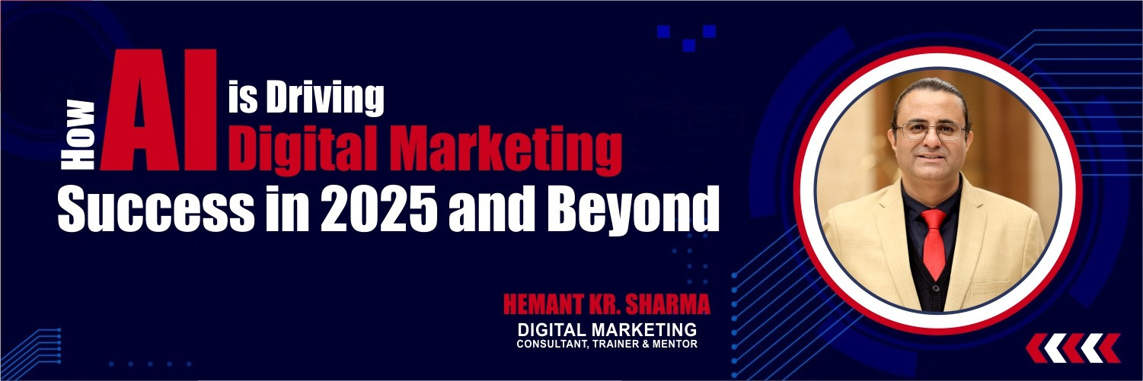

AI is Driving Digital Marketing Success in 2025
AI is making marketing smarter, faster, and more efficient
Hemant Kr. Sharma
TALK TO HEMANT
+91 9811681687 (Mobile & SMS)
+91 9999610527 (WhatsApp)
mail @ hemant . co . in
DIGITAL MARKETING CONSULTANT, TRAINER & MENTOR

Slide 2
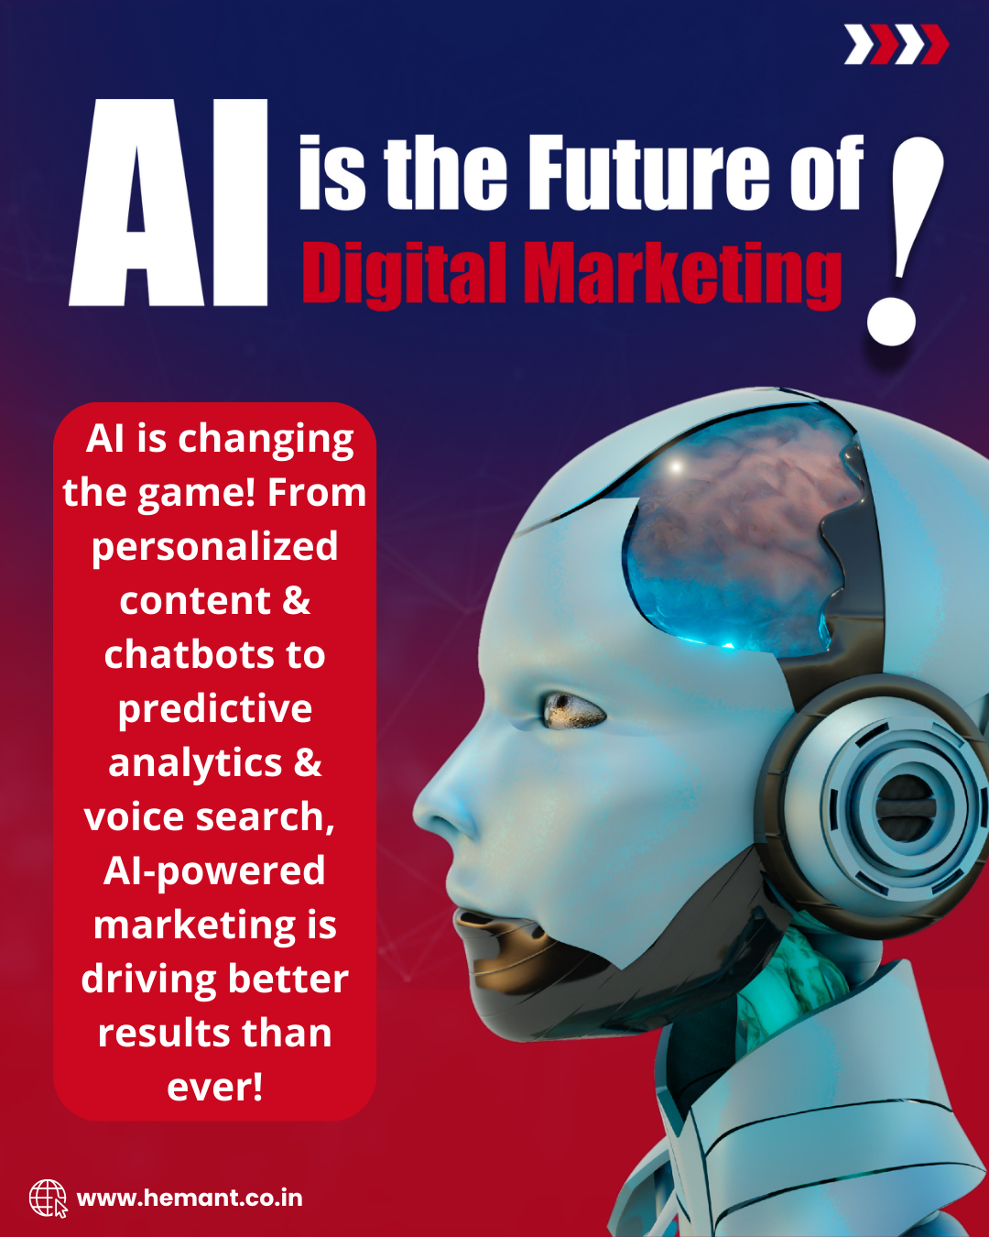
AI is Reshaping Digital Marketing in 2025
🔹 AI helps marketers create highly personalized customer experiences by analyzing user behavior, preferences, and past interactions.
🔹 Brands use AI-powered recommendations to suggest products, services, or content based on real-time data.

Slide 3
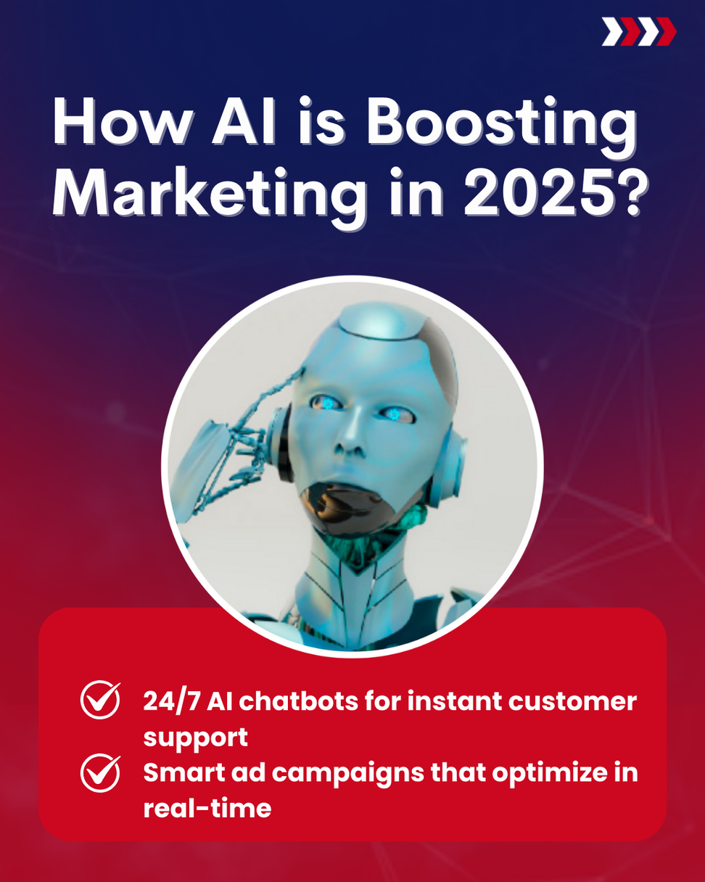
AI-Powered Chatbots & Virtual Assistants
🔹 AI chatbots provide instant responses to customer queries, improving engagement and reducing response time by over 60%.
🔹 Virtual assistants automate lead generation by answering FAQs, booking appointments, and qualifying leads.

Slide 4
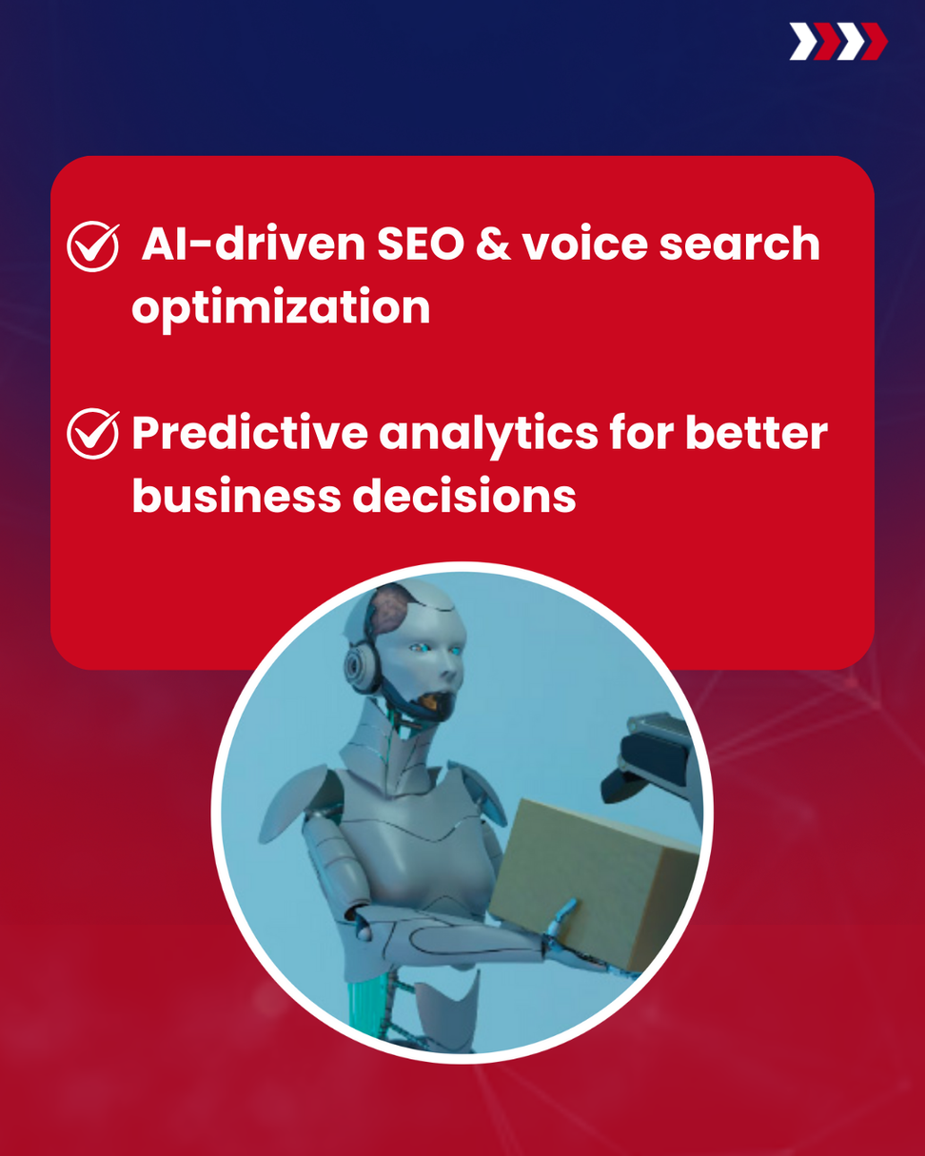
AI-Optimized SEO & Voice Search
🔹 AI analyzes search trends and predicts keywords that will drive the most traffic.
🔹 AI-powered SEO tools help optimize content for Google’s AI-driven algorithms.

Slide 5
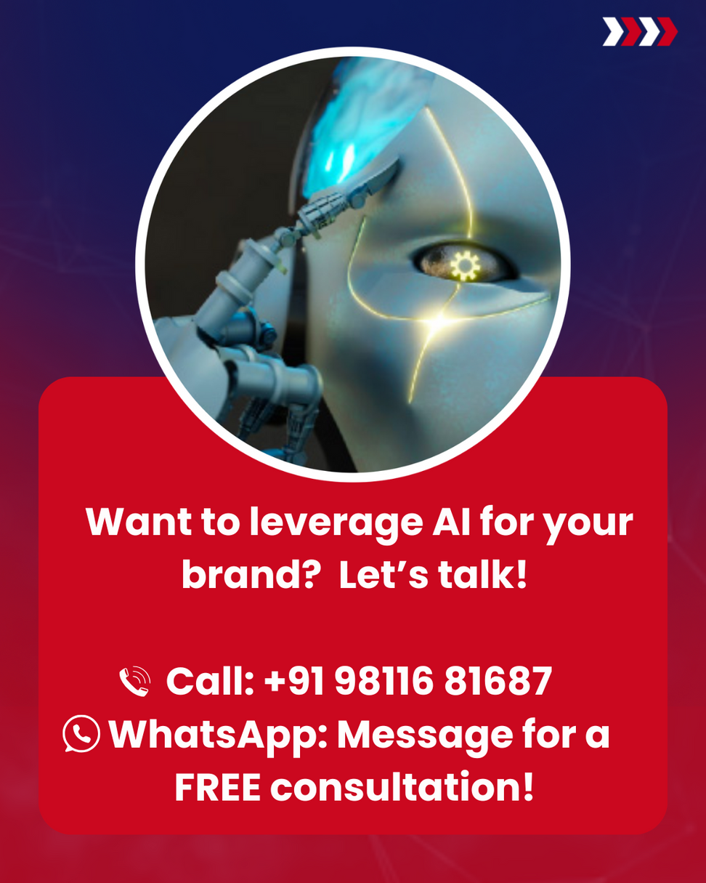
Ready to future-proof your marketing strategy with AI?
Whether you’re a small business, startup, or enterprise, integrating AI into your digital marketing strategy is no longer optional—it’s essential!

Slide 6
AI is changing the game! From personalized content & chatbots to predictive analytics & voice search, AI-powered marketing is driving better results than ever!
📞 Call now: +91 98116 81687
💬 WhatsApp: Message us for a FREE consultation!
#AIinMarketing #DigitalMarketing #MarketingTrends2025 #AISEO #FutureOfMarketing

